Slide 1





INTERNATIONAL NEURAL
NETWORK SOCIETY
INNS SECTION MEETING
AI & REGULATION
Tuesday 2 July 2024 19:30
Pacifico Yokohama, Japan WCCI 2024
ORGANISERS
AMANDA HORZYK
University of Edinburgh
ASIM ROY
Arizona State University
NICOLA FABIANO
Fabiano Law Firm - Ostrava University

Slide 2

SPEAKERS
MATEJA DUROVIC
King’s College London
Deputy Director of the Law School's Centre for Technology, Ethics, Law and Society (TELOS) and Academic Director of the Executive programme on Consumer Law
NICOLA FABIANO
Ostrava University
Adjunct Professor, Lawyer at Studio Legale Fabiano
NICOLE IVERARDI
Intesa Sanpaolo S.p.A.
Chief Data, A.I., Innovation and Technology Officer, Data and AI Ethicist
MAJA NISEVIC
KU Leuven at the Centre for IT & IP Law
Postdoctoral Researcher
COLTON CRUM
University of Notre Dame
Graduate Assistant at University of Notre Dame, US
AMANDA HORZYK
University of Edinburgh, Futures Institute
Graduate Teaching Assistant at Centre for Technomoral Futures Data and AI Ethics
Researcher in Innovation, Technology and the Law, Doctorate Student in AI Governance, Responsible NLP

Slide 3

OPEN DISCUSSION
  Open, collaborative discussion on the nexus of AI and Regulations
  Hear from researchers, legal academics, and industry representatives, lawyers on the current and imminent AI regulatory landscape and how it will impact how we design, develop and deploy Neural Networks models.
  We will be able to ask and attempt to address pertinent questions when pursuing trustworthy and responsible AI.
    Namely, how should we navigate the complex regulatory landscape?
    How do we envisage the future of responsible AI governance from the onset?

Slide 4
OPEN DISCUSSION
THEMES:
  How to Properly Regulate New Technologies?
Regulatory Challenges in the Contemporary Digital World
  Taking Training Seriously
Human Guidance and Management-Based Regulation of Artificial Intelligence
  When Critical Issues and Privacy Impact require Human and Ethical Oversight
AI Act and Large Language Models (LLMs): risk assessments and oversight
  Generative AI and its Impacts on Fundamental Rights: Explainability
The “Right to Explanation”, how do we safeguard fundametal rights?
  Civil Liability and AI Systems in Medicine
Allocation of Liability across the AI value chain: from developers to end-users

Slide 5
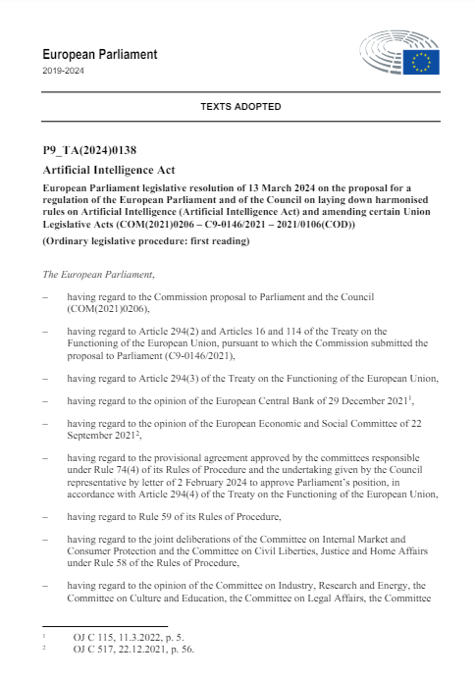
ARTIFICIAL INTELLIGENCE ACT
First Global Regulation on Aritificial Intelligence to address risks to health, safety and fundamental rights
5 Key Principles of the AI Act
1
Enhanced Product Regulation
2
Targets AI Systems and Risks Generated by AI Systems
3
Risk-Based and Life Cycle Approach
4
Foster Trust across entire Value Chain
5
Facilitate Responsible Innovation: Encourage Trustworthy
and Human-Centric AI Development

Slide 6

ARTIFICIAL INTELLIGENCE ACT
The Proposed Rules will:
  address risks specifically created by AI applications;
  prohibit AI practices that pose unacceptable risks;
  determine a list of high-risk applications;
  set clear requirements for AI systems for high-risk applications;
  define specific obligations deployers and providers of high-risk AI applications;
  require a conformity assessment before a given AI system is put into service or placed on the market;
  put enforcement in place after a given AI system is placed into the market;
  establish a governance structure at European and national level.

Slide 7
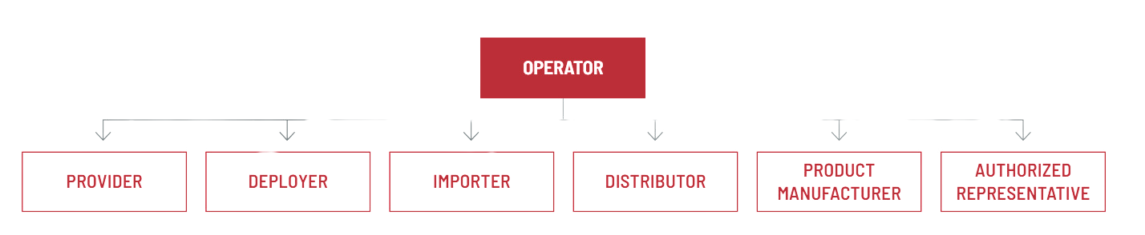
ARTIFICIAL INTELLIGENCE ACT
Who are you?
IAPP: EU AI Act Compliance Matrix: https://iapp.org/resources/article/eu-ai-act-compliance-matrix/:
Provider
  Art 3(3): natural or legal person, public authority, agency or other body that develops an AI system or a general-purpose AI model or that has an AI system or a general-purpose AI model developed and places it on the market or puts the AI system into service under its own name or trademark, whether for payment or free of charge.
  Established/located in the EU or third country if you place AI system on the market or put it into service in the EU, or if output produced by the AI system is used in the EU
  Most responsibilities fall on the providers - this concerns developers or those commissioning development by IT experts on their behalf

Slide 8
ARTIFICIAL INTELLIGENCE ACT
Who are you?
IAPP: EU AI Act Compliance Matrix: https://iapp.org/resources/article/eu-ai-act-compliance-matrix/:
Deployer
  Art 3(4): "a natural or legal person, public authority, agency, or other body using an AI system under its authority”
  Does NOT include: “natural persons using AI systems in the course of a purely person non-professional activity” (Art 2(10))
  Deployers may be established or located within the EU or in a third country, if the output produced by the AI system is used in the EU.

Slide 9
ARTIFICIAL INTELLIGENCE ACT
Who are you?
IAPP: EU AI Act Compliance Matrix: https://iapp.org/resources/article/eu-ai-act-compliance-matrix/:
Distributors
  Article 3(7) "a natural or legal person in the supply chain, other than the provider or the importer, that makes an AI system available on the Union market."
Importer
  Art 3(6) "a natural or legal person located or established in the Union that places on the market an AI system that bears the name or trademark of a natural or legal person established in a third country."

Slide 10
ARTIFICIAL INTELLIGENCE ACT
Scope, what is NOT included?
  AI systems and AI models and output "specifically developed and put into service for the sole purpose of scientific research and development." [Art 2(6)]
  Research, testing or development activity regarding AI systems or models prior to them being placed on the market or put into service [Art 2(8)]
  Deployers who are natural persons using AI systems "in the course of a purely personal non-professional activity"
  AI systems "released under free and open-source licenses, unless they are placed on the market or put into service as high-risk AI systems or as an AI system that falls under Article 5 or 50
  AI systems place on the market, put into service, or used with or without modification exclusively for military, defense or national security purposes.
  Public authorities in a third country and international organizations where those authorities or organizations use AI systems in the framework of international cooperation or agreements for law enforcement and judicial cooperation with the EU or with one or more member states provided adequate safeguards to fundamental rights and freedoms

Slide 11

ARTIFICIAL INTELLIGENCE ACT
Key Concepts (definitions Art 3)
AI SYSTEMS
‘AI system’ means a machine-based system that is designed to operate with varying levels of autonomy and that may exhibit adaptiveness after deployment, and that, for explicit or implicit objectives, infers, from the input it receives, how to generate outputs such as predictions, content, recommendations, or decisions that can influence physical or virtual environments;
AI SYSTEMS
vs AI Models
Recital 97:
  Although AI models are essential components of AI systems, they do not constitute AI systems on their own. AI models require the addition of further components, such as e.g. a user interface, to become AI systems.
  AI models are typically integrated into and form part of AI systems

Slide 12
ARTIFICIAL INTELLIGENCE ACT
Key Concepts (definitions Art 3)
General Purpose AI Models
‘General-purpose AI model’ means an AI model, including where such an AI model is trained with a large amount of data using self-supervision at scale, that displays significant generality and is capable of competently performing a wide range of distinct tasks regardless of the way the model is placed on the market and that can be integrated into a variety of downstream systems or applications, except AI models that are used for research, development or prototyping activities before they are placed on the market;
Specific Rules apply
  Examples: OpenAI ChatGPT-3, 4, 4o, DALL-E; Google’s Bard, other generative models e.g. LLMs, image generators using diffusion models etc.

Slide 13
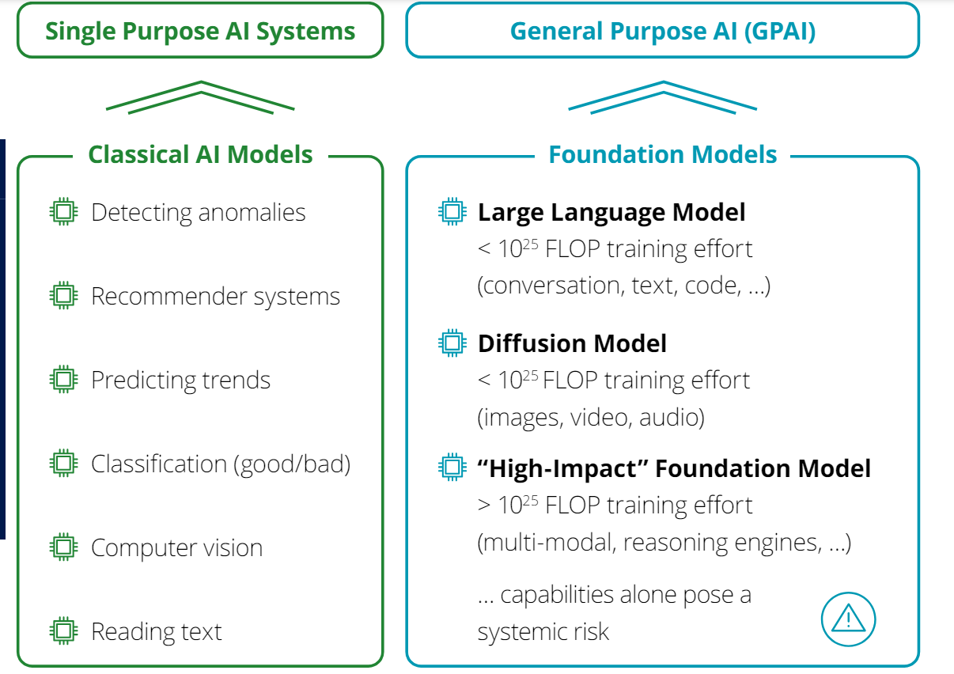
ARTIFICIAL INTELLIGENCE ACT
Key Concepts (definitions Art 3)
The AI Act @ April 2024 : Europe΄s Comprehensive AI Regulation Deloiitte 02.05.2024
Notes:
This is Non-exhaustive and the rules may apply to AI systems which are not listed here.

Slide 14
ARTIFICIAL INTELLIGENCE ACT
Key Concepts (definitions Art 3)
General Purpose AI Models
Providers Responsible
  Developers of foundation models, deployers if core capabilities substantially altered
  Risk categorization: Differentiation in between GPAI and “high-impact” GPAI posing systemic risk
GPAI
  Transparency obligations, including technical documentation, training data respecting copyrights, watermarking of AI generated content
Systemic Risk GPAI
  Stringent obligations similar to high-risk AI systems:
    model evaluations
    assess and mitigate systemic risks
    conduct adversarial testing
    report to the Commission on serious incidents
    ensure cyber security
    report on their energy efficiency
    adherence to codes of practice until harmonized EU standards published

Slide 15
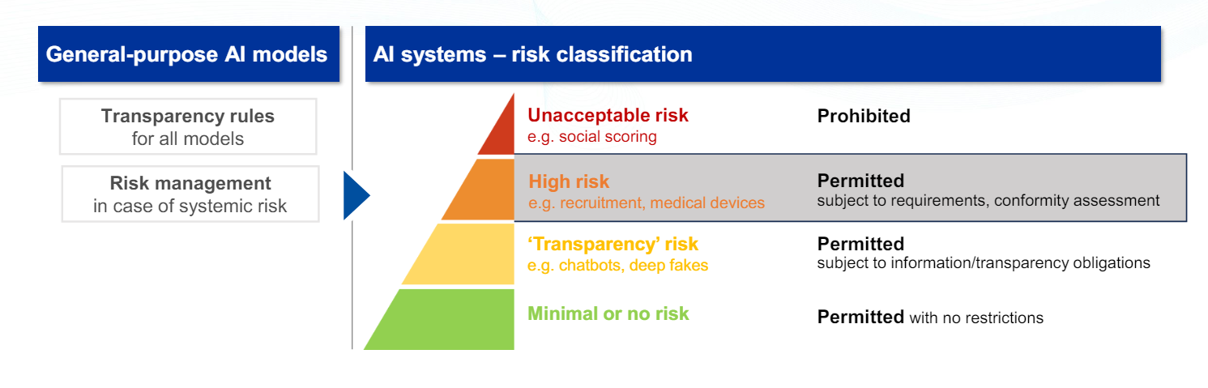
ARTIFICIAL INTELLIGENCE ACT
Classification
AI Office: First Webinar on Risk Management Logic of the AI Act and Related Standards, 2024
  Imposes Mandatory Requirements for all high-risk AI system before they can be used and strong system of enforcement and post-market monitoring
  Risk: the combination of the probability of an occurrence of harm and the severity of that harm

Slide 16
ARTIFICIAL INTELLIGENCE ACT
Classification: Prohibited Risks [Chapter II, Art 5]
  Behavioural Manipulation subliminal techniques that are purposefully manipulative or deceptive, impairing informed decision-making
  System that exploits vulnerabilities to materially destort behaviour, causes or likely to cause significant harm (e.g. due to age, disability or socio-economic status)
  Social Scoring
  Real-time Biometric Identification* (with limited exceptions)
  Emotion Recognition in the workplace and in schools* (apart of pain and fatigue)
Implementation: 6 months upon entry into force

Slide 17
ARTIFICIAL INTELLIGENCE ACT
Classification: High Risk [Chapter III, Art 5]:
  Prodcuts listed under EU Safety legislation (e.g. machinery, toys, aviation, cars, medical devices)
  Annex III:
    Management and operation of critical infrastructure
    Medical devices
    Employment, worker management, recruitment
    Access to essential private & public services/benefits
    Law enforcement
    Migration, asylum and border control management
    Administration of justice
    Influencing the outcome of elections, the democratic process
  Real-time remote biometric identification (RBI) under strict conditions and for a limited time and location: exception models supporting procedural tasks
Implementation: 24–36 months upon entry into force

Slide 18
ARTIFICIAL INTELLIGENCE ACT
Risks Covered Examples
Providers will have to address health and safety risks as well as risks to fundamental rights, including
  Article 10.2 (f) “biases that are likely to affect the health and safety of persons, have a negative impact on fundamental rights or lead to discrimination prohibited under Union law, especially where data outputs influence inputs for future operations”
  Article 9.9 adverse impacts on persons under the age of 18 and, other vulnerable groups
  Article 14.4 (b) Automation bias (e.g. users automatically relying or over-relying on the output produced by the AI)
  Article 15.4 for systems that continue to learn “the risk of possibly biased outputs influencing input for future operations (feedback loops), and as to ensure that any such feedback loops are duly addressed with appropriate mitigation measures”
  Article 15.5 Cybersecurity risks specific to AI systems
Articles 8-15 Cover the Requirements for HRAIS

Slide 19
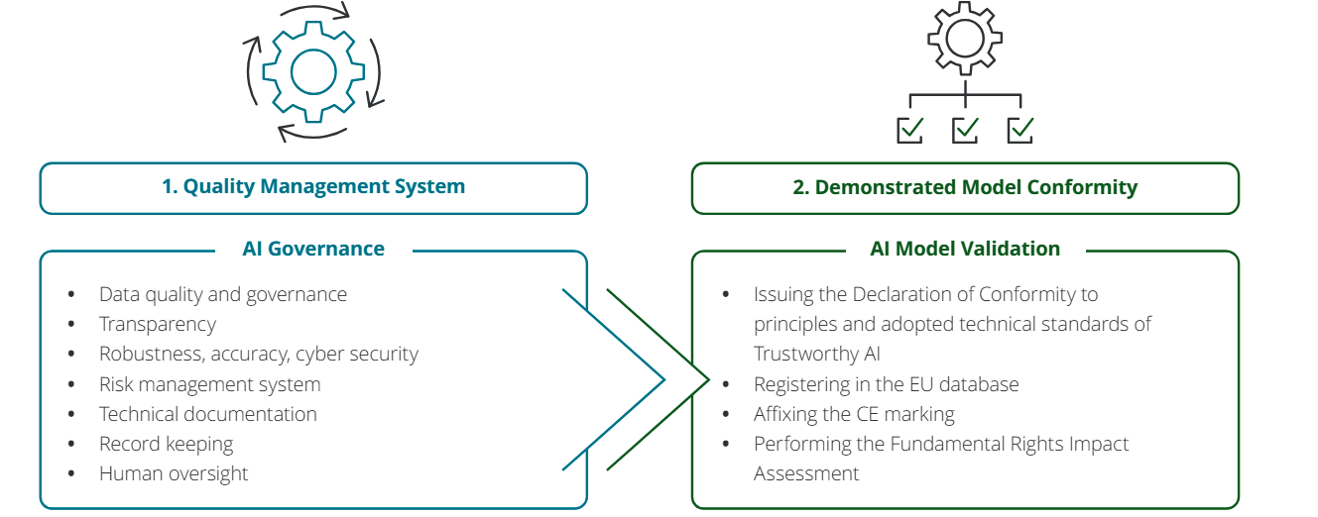
HRAIS Key Provisions: At a Glance
  Providers of high-risk AI must demonstrate conformity prior to market placement, to be maintain throughout the lifecycle
IAPP: EU AI Act Compliance Matrix: https://iapp.org/resources/article/eu-ai-act-compliance-matrix/:

Slide 20
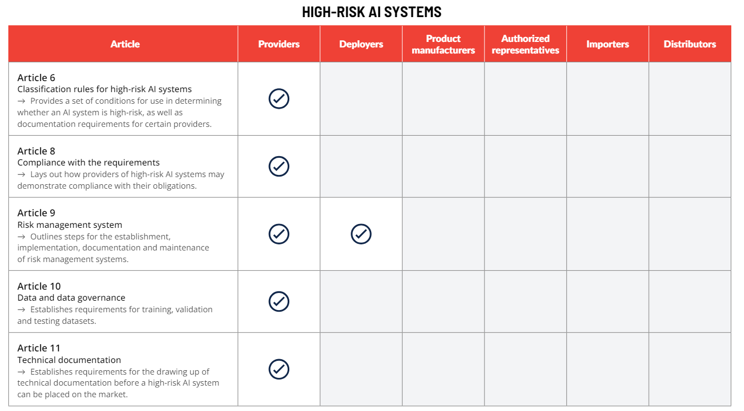
HRAIS Key Provisions: At a Glance
IAPP: EU AI Act Compliance Matrix: https://iapp.org/resources/article/eu-ai-act-compliance-matrix/:

Slide 21
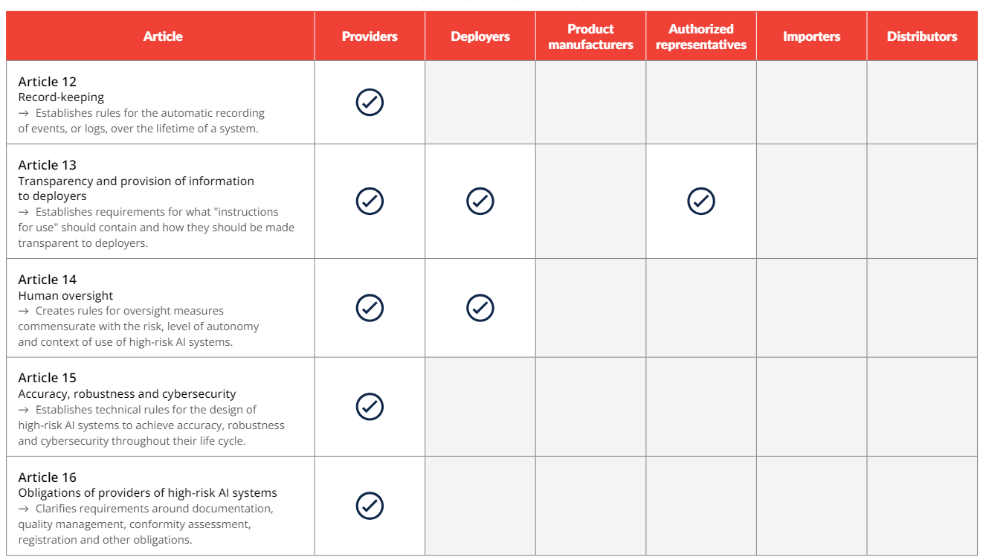
HRAIS Key Provisions: At a Glance
IAPP: EU AI Act Compliance Matrix: https://iapp.org/resources/article/eu-ai-act-compliance-matrix/:

Slide 22
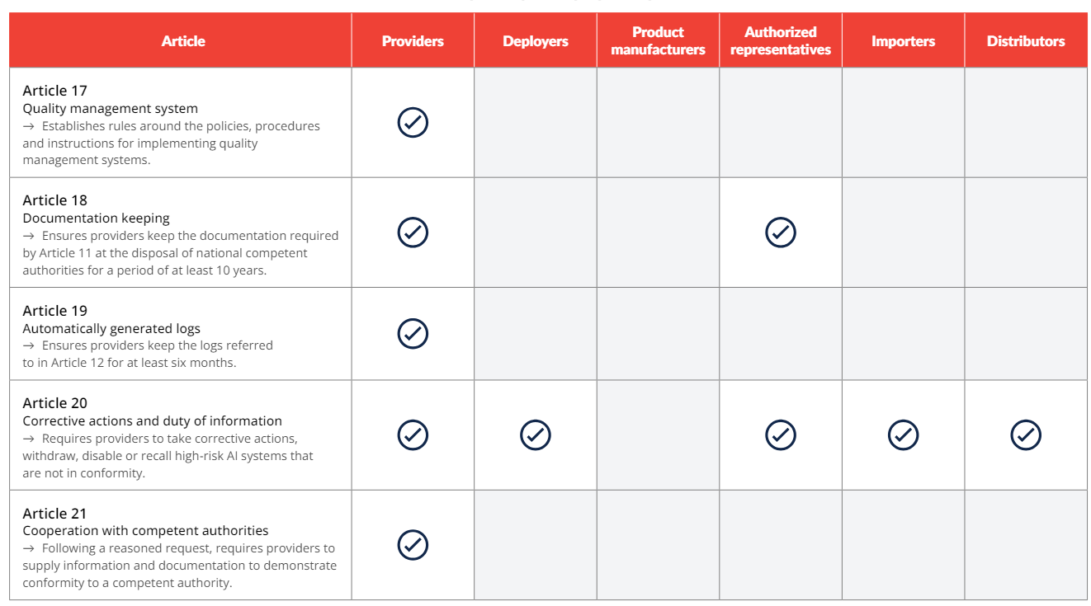
HRAIS Key Provisions: At a Glance
IAPP: EU AI Act Compliance Matrix: https://iapp.org/resources/article/eu-ai-act-compliance-matrix/:

Slide 23
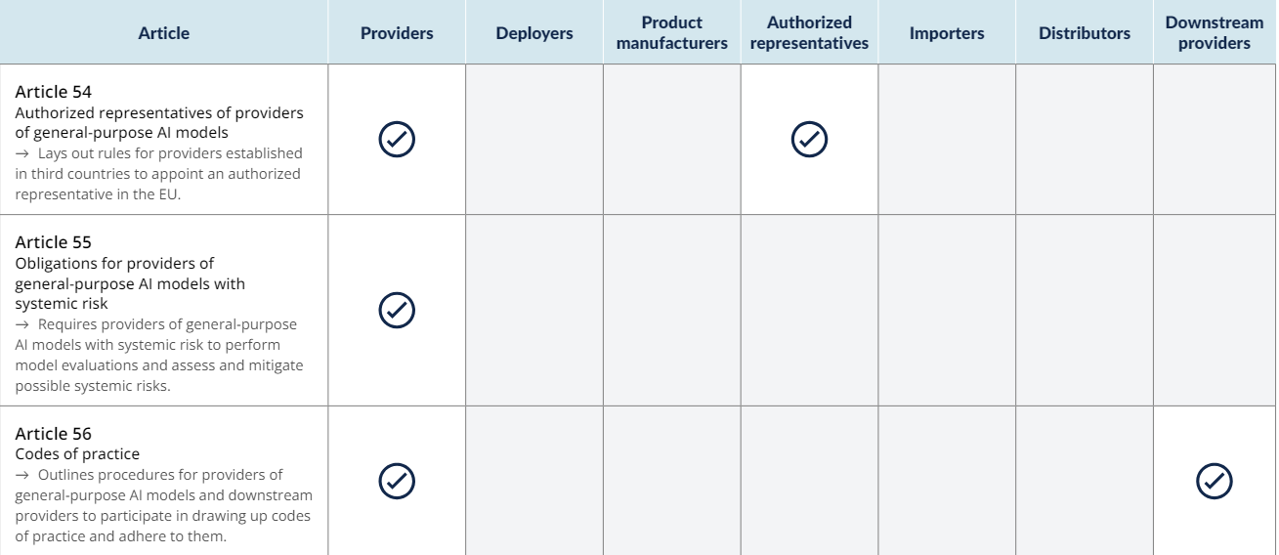
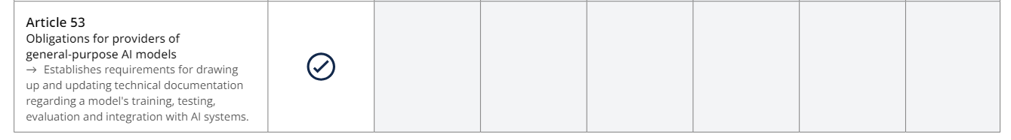
GPAIS Key Provisions: At a Glance
IAPP: EU AI Act Compliance Matrix: https://iapp.org/resources/article/eu-ai-act-compliance-matrix/:

Slide 24
ARTIFICIAL INTELLIGENCE ACT
Compliance, Enforcement, Consequences
Compliance
  Providers (developers, deployers, …) must establish:
    Quality Management Systems (art 17), and
    validate high-risk AI systems and a Risk Management System (Art 9)
Enforcement
  EU-wide authorities will coordinate across member states and follow larger topics, such as foundation models and GPAI.
  National supervisors will enforce compliance, appointing “notified bodies” (permitted 3rd party auditors) to assess conformity in specific cases
Consequences:
  Fines range from 35 m€ / 7% global turnover (prohibited cases), 15 m€ / 3% (other infringements) to 7,5 m€ / 1,5% (reporting errors), as well as potential non-monetary penalties, such as forced removal of the AI system from the market.

Slide 25





ARTIFICIAL INTELLIGENCE ACT
Implementation & Complaince Timeline
24 Months post-EIF
Provisions on HRAIS apply
General Act applies
At least 1 Regulatory Sandbox
per Member State
6 Months post-EIF
Scope & Definitions,
Provisions on Prohibited AI apply
June/July
AI Act Enters
Into Force (EFI)
Member States to identify fundamental rights
authorities
12 Months post-EIF
Provisions on GPAIS apply
Member States lay rules on Penalties
Commission Guidance on Serious Incident Reporting
36 Months
GPAIS legacy systems
Obligations Annex 1
(under NLF)

Slide 26
ARTIFICIAL INTELLIGENCE ACT
Standards and Regulatory Sandboxes
  The AI Act ONLY outlines essential requirements for the product (here, AI system) must meet
  The Goals are to be Operationalised through Technical Standards
    They are voluntary BUT may be a useful tool to operationalise how to meet these public objectives and safety characteristics
  The AI Act cannot be read on its own, we need to look at the entire New Legislative Framework System/logic which outlines definitions, procedures and structures
  Joint Research Centre works in close collaboration with the European Standardisation Organisations:
    To provide guidance and ensure that they are fit for the purpose
    This was requested even before the drafting of the AI Act, current standards may not align well with the specificity of the AI Act
  Recognised Standards may be evaluated and approved by the AI Office, to become Harmonised Standards: give a Presumption of Conformity with the Act
  There is unlikely going to be ONE standard, it may be a collection of standards that must be implemented, not exhaustive, limited

Slide 27
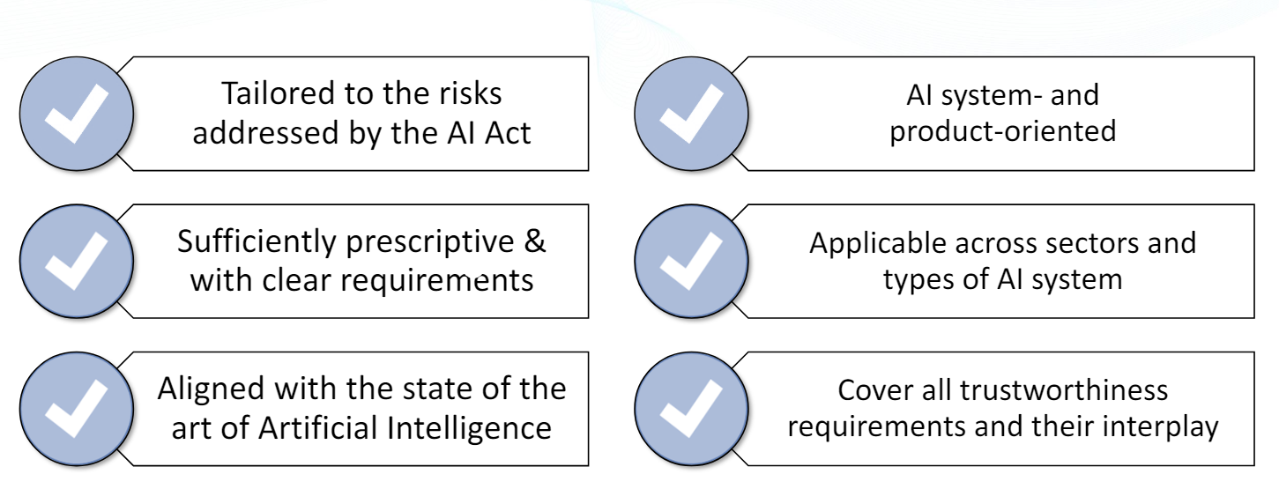
ARTIFICIAL INTELLIGENCE ACT
Standards and Regulatory Sandboxes
Upcoming standards will be developed by e.g. ESO (CEN, CENELEC and ETSI), which will be:
AI Office: First Webinar on Risk Management Logic of the AI Act and Related Standards, 2024

Slide 28
ARTIFICIAL INTELLIGENCE ACT
Standards and Regulatory Sandboxes (art 58)
Regulatory Sandboxes refer to regulatory tools allowing businesses to test and experiment with new and innovative products, services or businesses under supervision of a regulator for a limited period of time e.g. in testing and experimentation facilities (TEFs) to provide technical support and testing facilities
Goals
  Foster Business Learning (development and testing of innovations in a real-world environment)
  Support Regulatory Learning (formulation of experimental legal regimes to guide and support businesses in their innovation activities under the supervision of a regulatory authority)
Rules
  AI regulatory sandboxes are open to any applying provider or prospective provider of an AI system who fulfils eligibility and selection criteria
  Access to the AI regulatory sandboxes is free of charge for SMEs (with priority access), including start-ups, without prejudice to exceptional costs that national competent authorities may recover in a fair and proportionate manner;
  Facilitate compliance with conformity assessment obligations of providers and prospective providers, by means of the learning outcomes of the AI regulatory sandboxes

Slide 29
ARTIFICIAL INTELLIGENCE ACT
Standards and Regulatory Sandboxes (art 58)
  According to a World Bank study, more than 50 countries are currently experimenting with fintech sandboxes.
  Japan, in 2018 a Sandbox Regime
    Open to organisations and companies both in and outside Japan willing to experiment with new technologies, including blockchain, AI, and the internet of things (IoT), in fields such as financial services healthcare and transportation.
    Norway established a regulatory sandbox as part of its national AI strategy, to provide guidance on personal data protection for private and public companies.
    UK, a sandbox has been set up to explore new technologies such as voice biometrics and facial recognition technology, and the related data protection issues.
European Parliament Briefing, Artificial Intelligence and Regulatory Sandboxes
https://www.europarl.europa.eu/RegData/etudes/BRIE/2022/733544/EPRS_BRI(2022)733544_EN.pdf

Slide 30
OPEN DISCUSSION
THEMES:
  How to Properly Regulate New Technologies?
Regulatory Challenges in the Contemporary Digital World
  Taking Training Seriously
Human Guidance and Management-Based Regulation of Artificial Intelligence
  When Critical Issues and Privacy Impact require Human and Ethical Oversight
AI Act and Large Language Models (LLMs): risk assessments and oversight
  Generative AI and its Impacts on Fundamental Rights: Explainability
The “Right to Explanation”, how do we safeguard fundametal rights?
  Civil Liability and AI Systems in Medicine
Allocation of Liability across the AI value chain: from developers to end-users

Slide 31
INTERNATIONAL NEURAL
NETWORK SOCIETY
INNS SECTION MEETING
AI & REGULATION
THANK YOU FOR JOINING US
ORGANISERS
AMANDA HORZYK
University of Edinburgh
ASIM ROY
Arizona State University
NICOLA FABIANO
Fabiano Law Firm - Ostrava University

