Slide 1
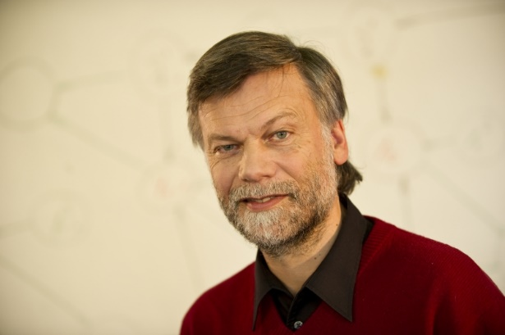
CV: Dr. Hans Georg Zimmermann, Chief Scientist at Fraunhofer IIS
Study of Mathematics, Computer Science and Economics at University of Bonn (1982 Diplom in Mathematics - Control Theory / 1987 PhD in Mathematical Finance - Game Theory).
1987- Nov. 2017 at Siemens Corporate Technology in Munich (one of the founders of the Neural Network research at Siemens, since 2000 Senior Principal Research Scientist for Artificial Intelligence, Neural Networks and Forecasting).
Since Dec. 2017 at Fraunhofer IIS SCS Analytics in Nürnberg. Chief Scientist for Artificial Intelligence and Data Analytics at Fraunhofer and joint research with Siemens Corporate Technology.
Member of the Scientific Advisory Board of the German Society of Operations Research (GOR); Member of the Industry Advisory Board of the International Neural Network Society (INNS); Member of the German Mathematical Society (DMV)
Associate Research Fellow of the African Institute for Mathematical Sciences (AIMS) in Cape Town, South Africa.
hans.georg.zimmermann@scs.fraunhofer.de hans_georg.zimmermann.ext@siemens.com
Research Interests:
- Artificial Intelligence,
- Neural Networks,
- Data Analytics,
- Forecasting,
- Optimal Control.

